Slide 1


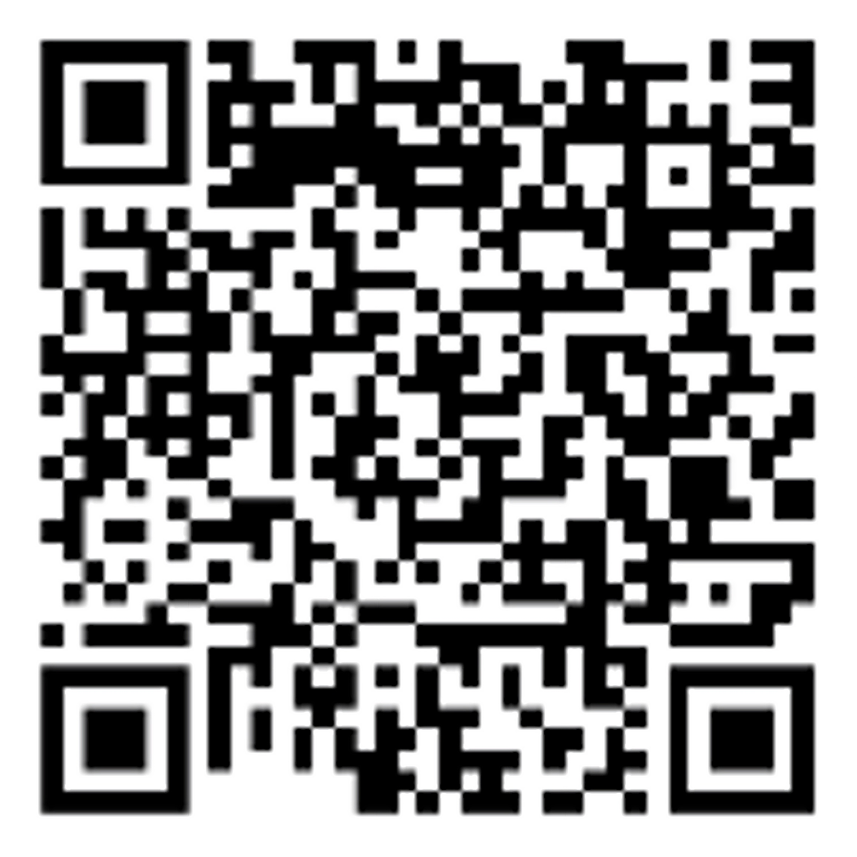
Decoding cellular complexity:
Single cell biology in the era of AI
In partnership with Helmholtz Munich
December 2–4, 2026 — Munich, Germany
Speakers
Ido Amit, Israel
Paolo Casale, Germany
Theodore Alexandrov, USA
Jinmiao Chen, Singapore
Tiannan Guo, China
Muzlifah Haniffa, UK
Hae Kyung Im, USA
Sten Linnarsson, Sweden
Mo Lotfollahi, UK
Matthias Mann, Germany
Andreas Moor, ETH Zurich, Switzerland
Dana Pe’er, USA
Rahul Satija, USA
Sydney Shaffer, USA
Liran Shlush, Israel
Ewa Szczurek, Germany
Kikuë Tachibana, Germany
Caroline Uhler, USA
Xun Xu, China
Judith Zaugg, Switzerland
Organizers
Carsten Marr, Helmholtz Munich, Germany
Fabian Theis, Helmholtz Munich, Germany
Barbara Treutlein, ETH Zurich, Switzerland
Bernadett Gaál, Editor-in-chief, Cell Systems
Judith Nicholson, Scientific editor, Cell
Genomics and Consulting editor, Cell
Abstract submission deadline: July 17, 2026
Early registration discount deadline: September 25, 2026
cell-symposia.com/single-cell-biology-2026

